Slide 1




Magician Integration Week – Cleaning Tool

Slide 2
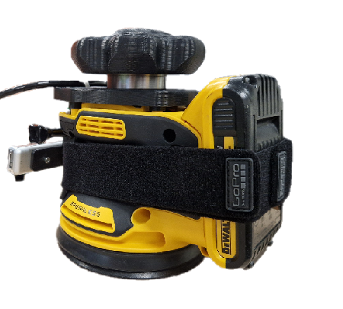
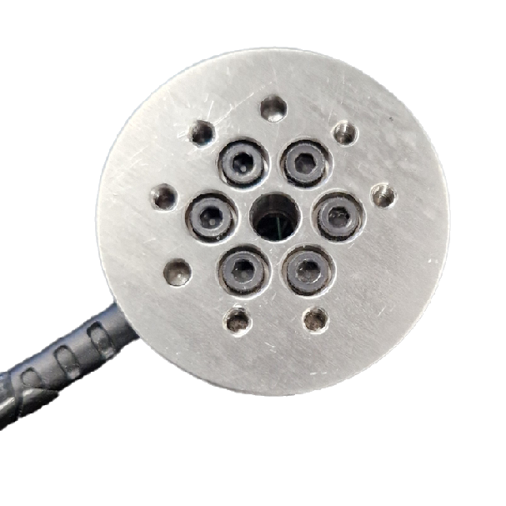
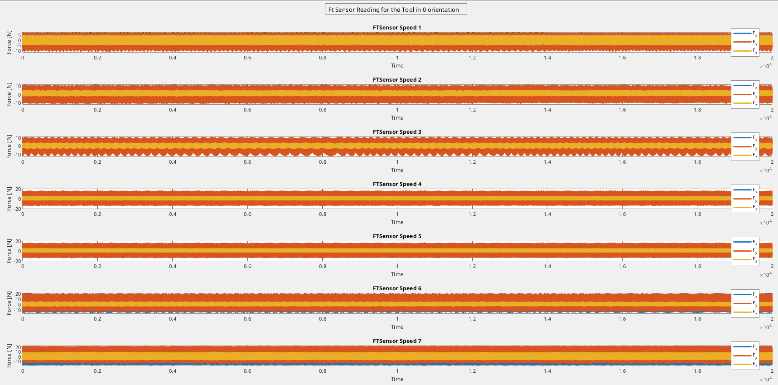
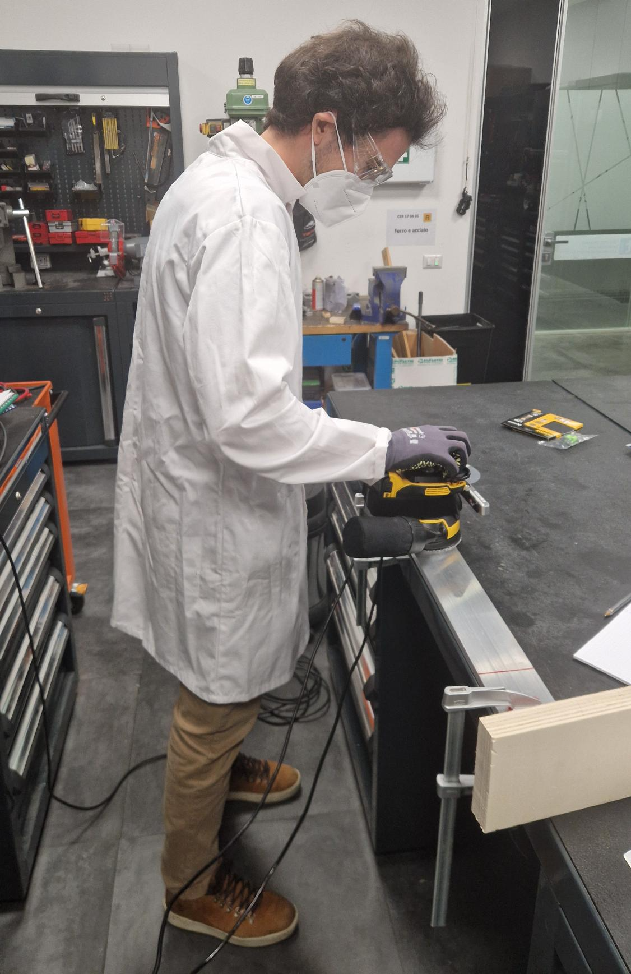
Work Status Update for the Project Magician
FT_ Mini-45

Slide 3
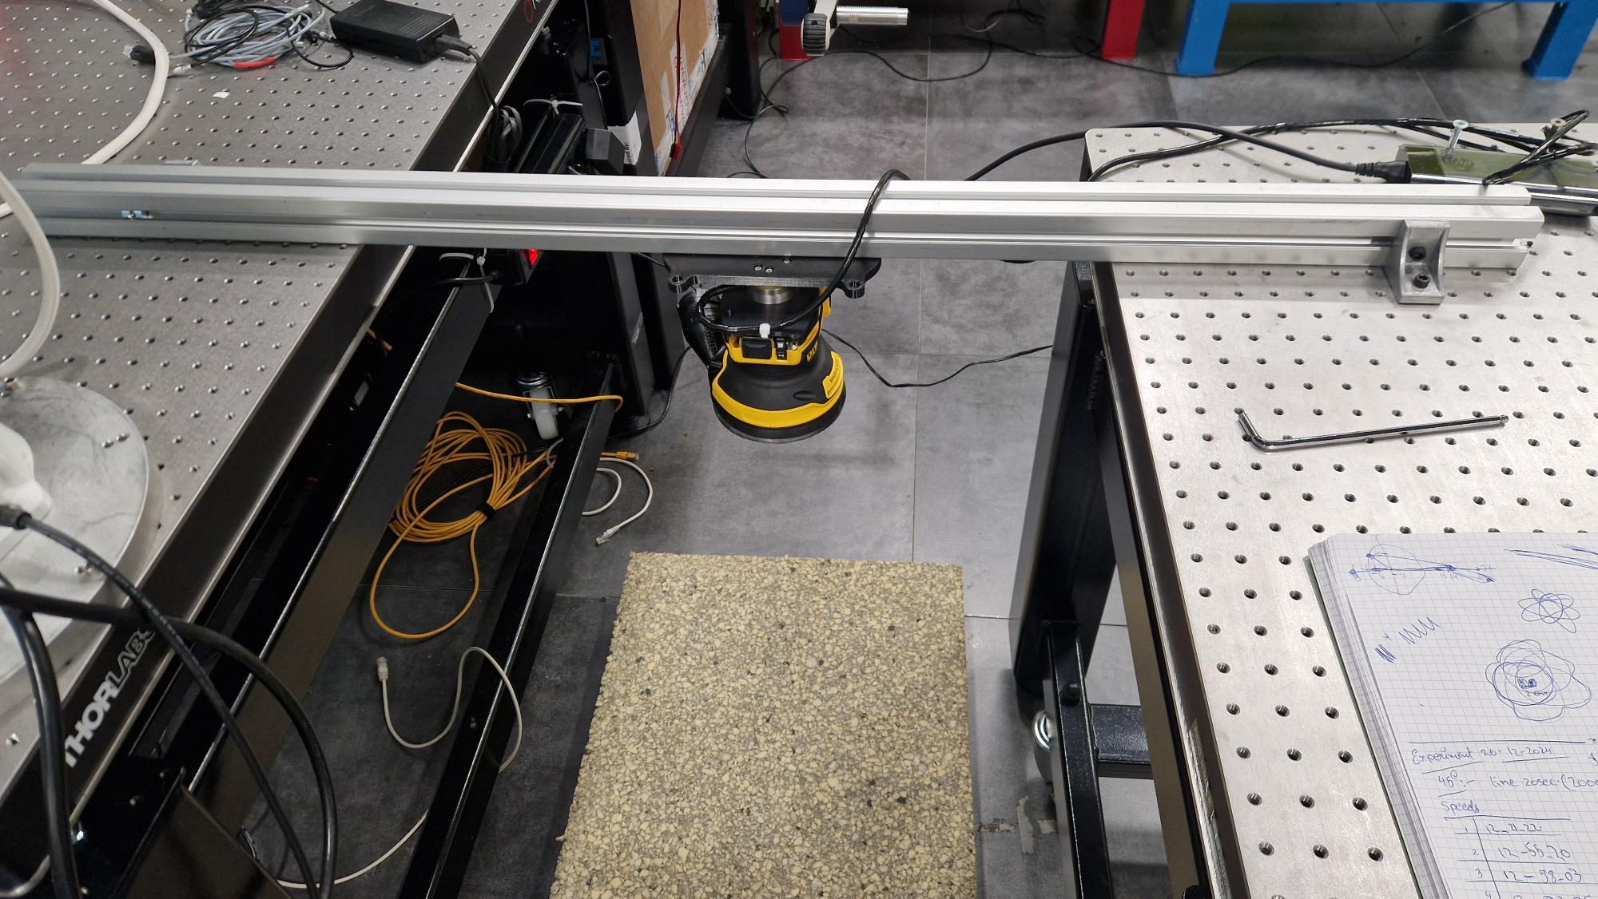
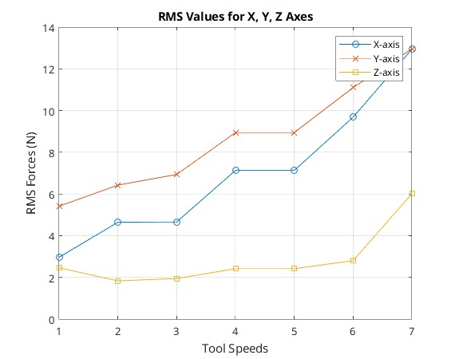
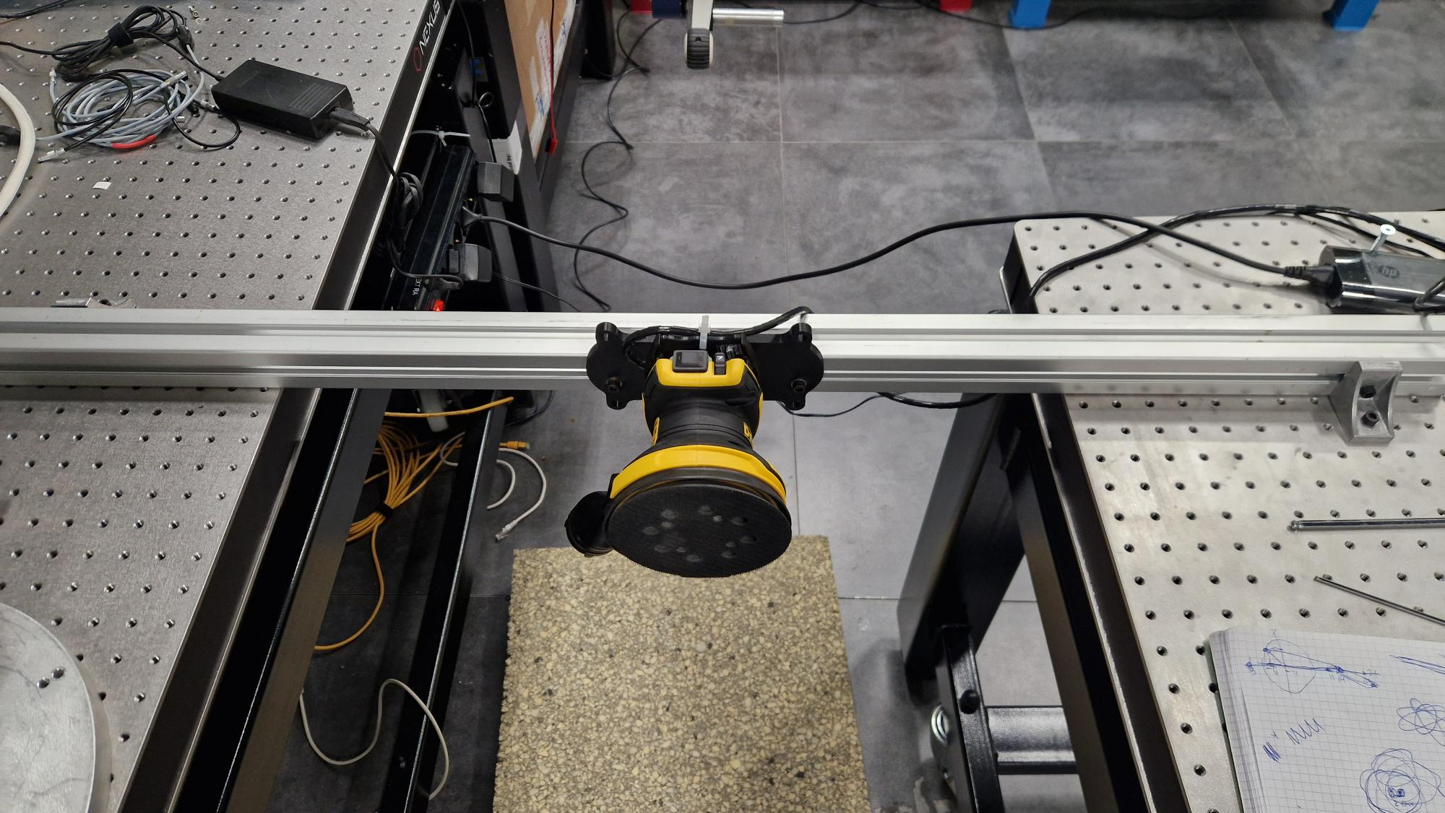
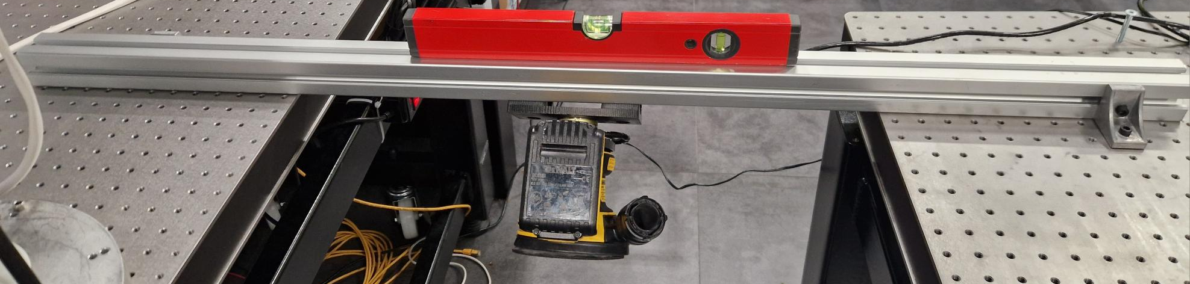
Free – Fixed Condition Experiment
Experimental Setup
0-degree orientation
90-degree orientation
In 45-degree orientation

Slide 4
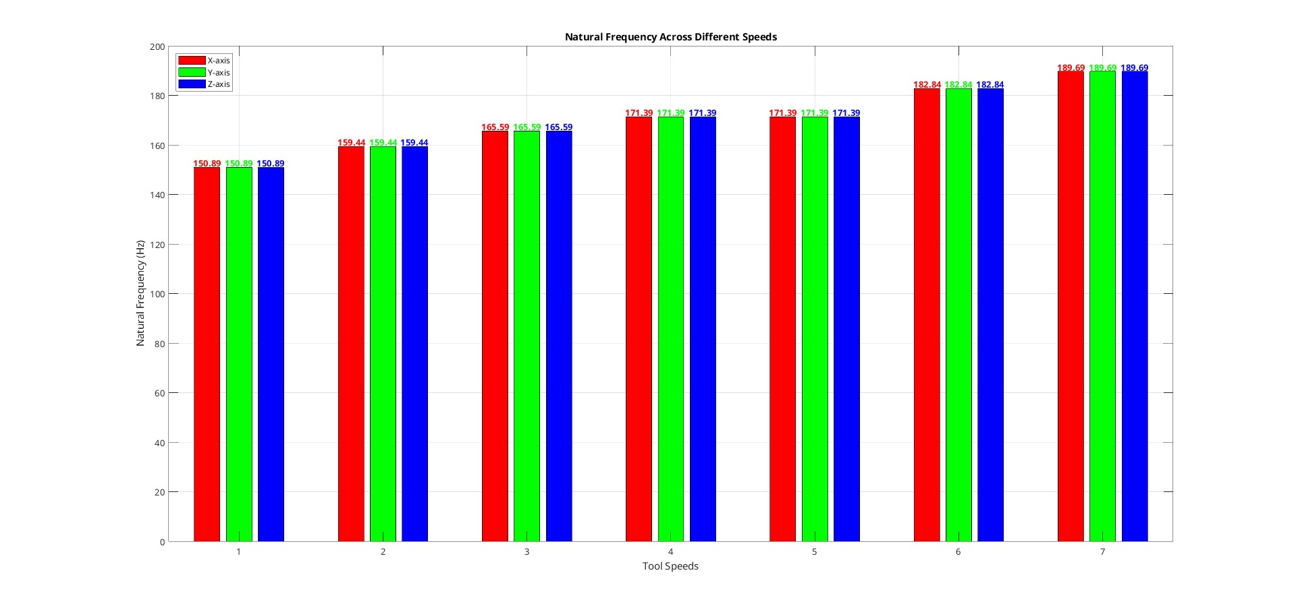
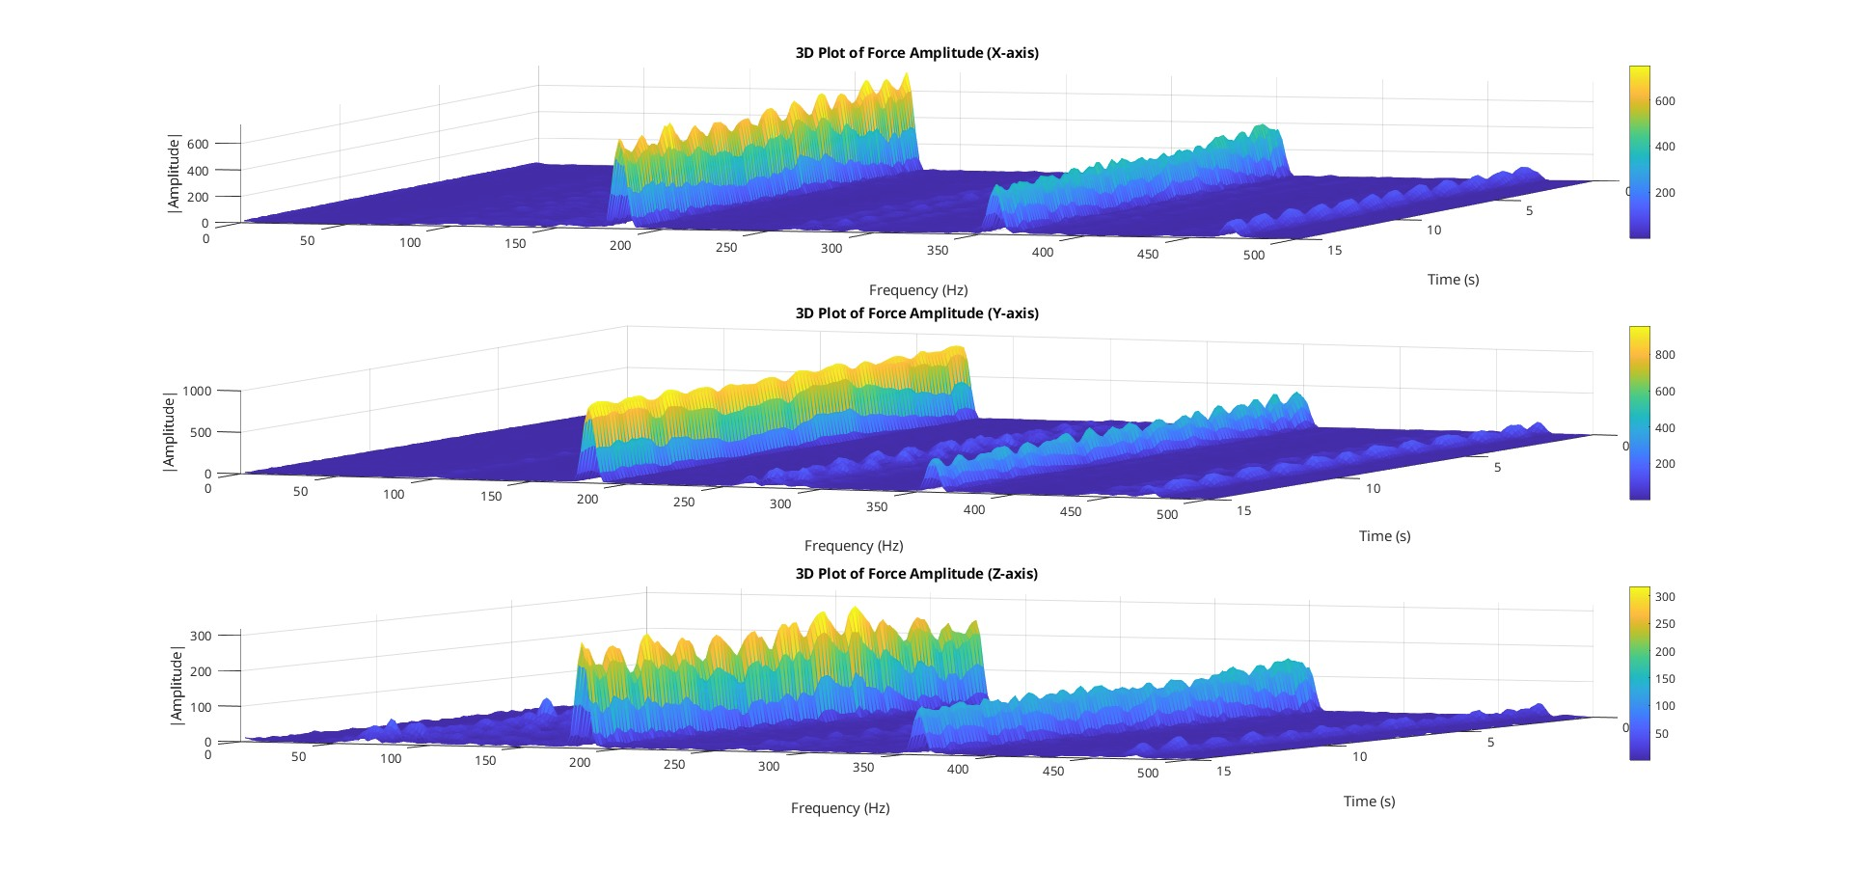

Work Status Update for the Project Magician
Tools Natural Frequency in 0 orientation (w_{n}) = 150 to 190 Hz
Calculated Stiffness Range ( k_{cal}) = 1.4 e+6 to approx. 2.2 e+6 N/m

Slide 5
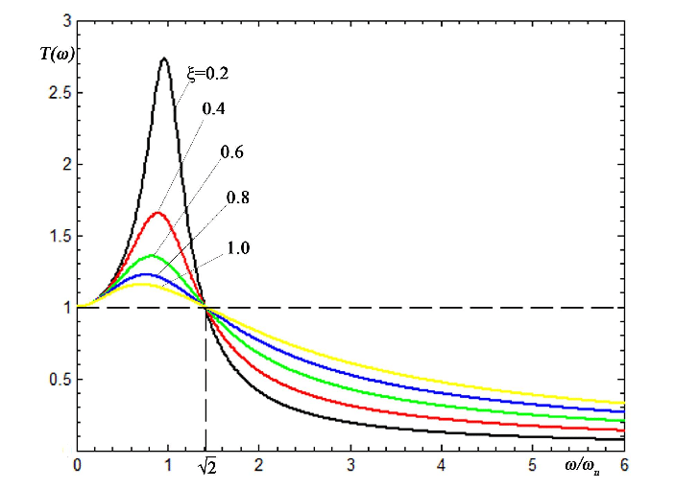
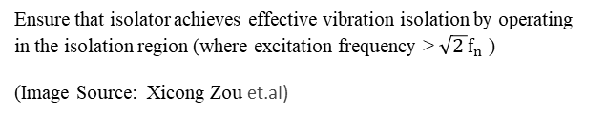
Vibration Isolator Parameters
Use isolators with low stiffness to lower natural frequency.
Ensure isolator frequency is below the source operating frequency.
Balance stiffness to prevent excessive deflection.
Test isolators to confirm proper vibration isolation.
Avoid overlap with source and receiver frequencies.
Isolator Region
Ensure that isolator achieves effective vibration isolation by operating in the isolation region (where excitation frequency > $\sqrt{2 }f_{n}$ ​)
(Image Source: Xicong Zou et.al)

Slide 6
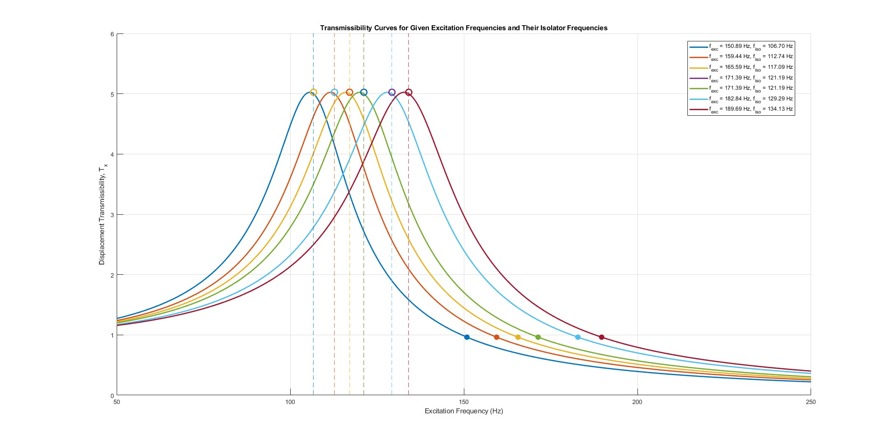
Free – Fixed Condition Experiment
In 0 orientation config
Desired isolator frequency range f_{iso} < 106 Hz

Slide 7
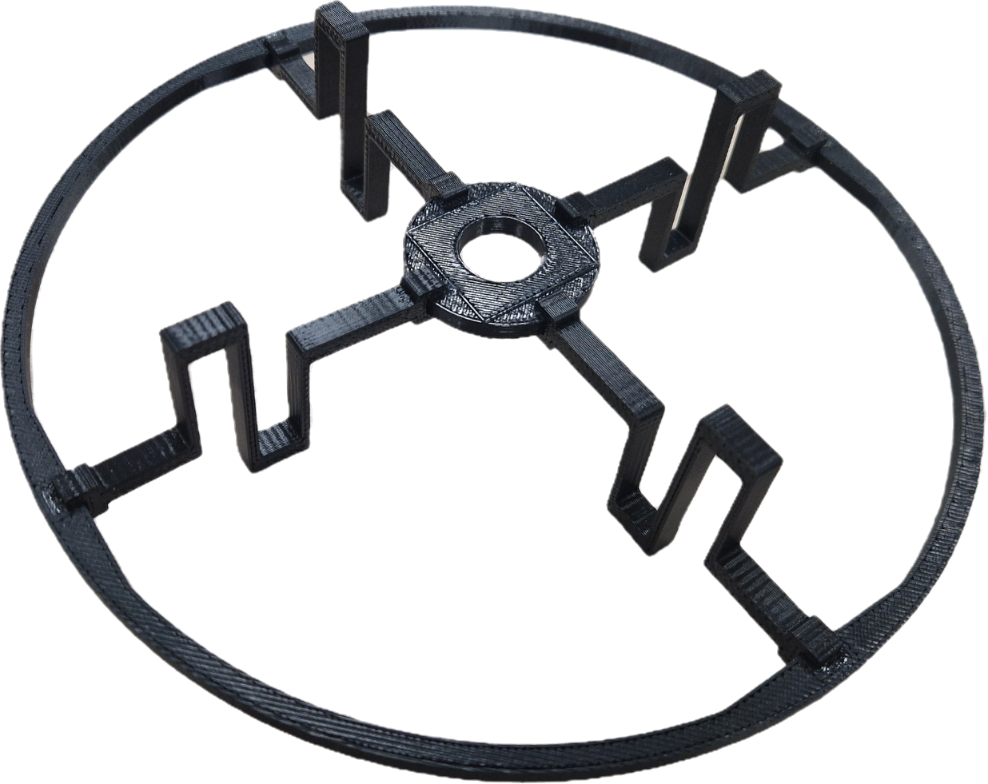
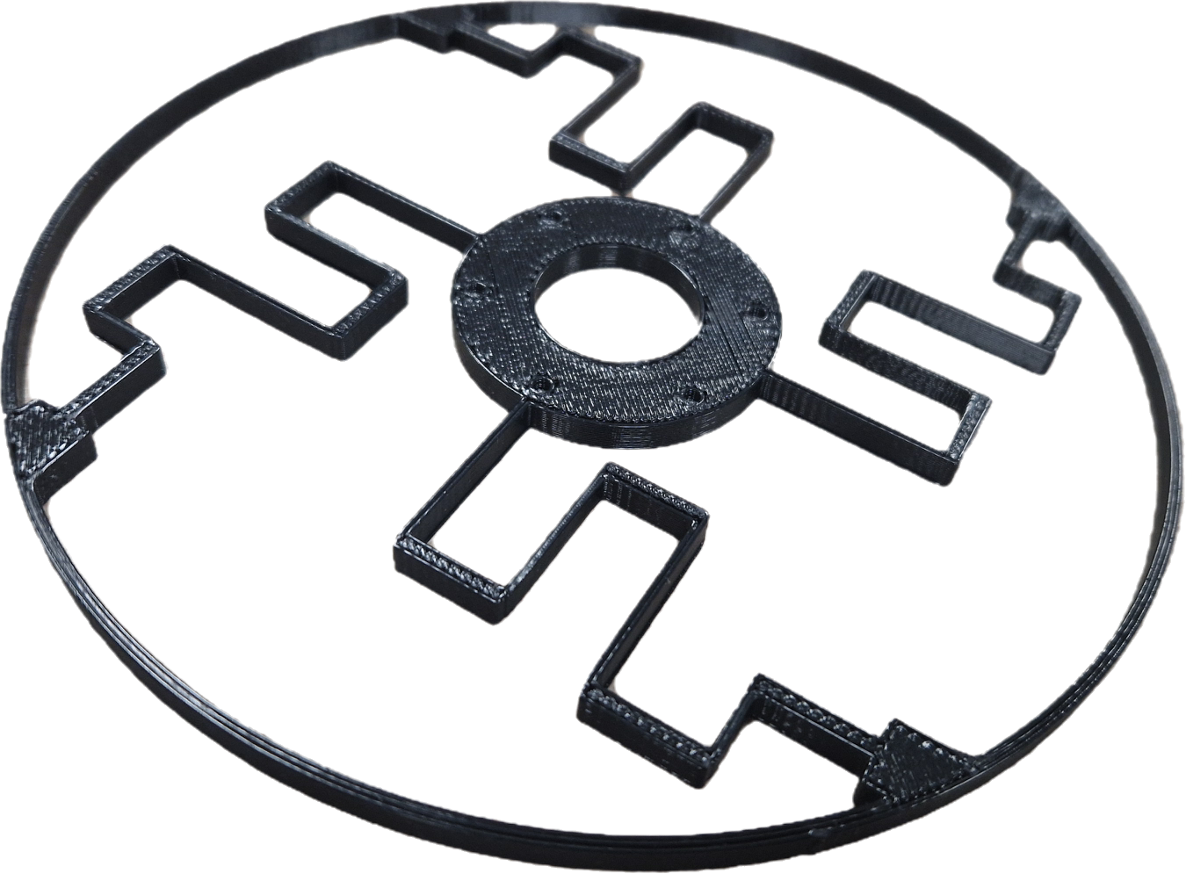
Initial Isolator Design Ideas
Planner Folded beam Vibration Isolation Platform Design
This folded beam design effectively dampens in-plane vibrations (x, y) but not axial (z) vibrations.
Simple to implement and beam stresses can be calculated using the Euler-Bernoulli bending equation.

Slide 8
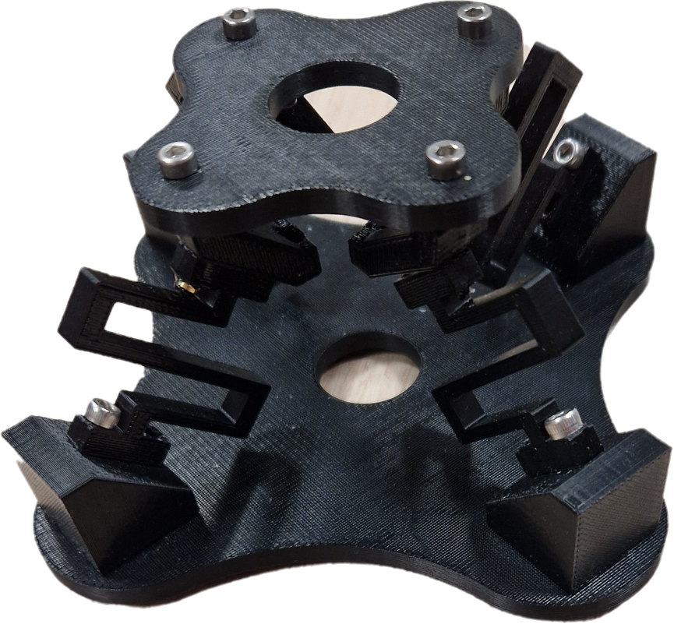
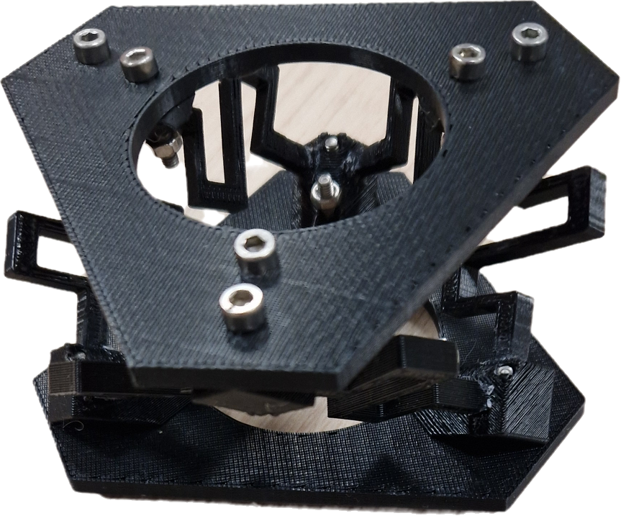
Initial Isolator Design Ideas
A Novel 3–3 Stewart–Gough isolator platform
This folded beam design effectively dampens vibrations in all six degrees of freedom.
It's a novel approach combining a rigid Stewart Gough platform with a folded beam structure.
Stress in each beam, under various loads, can be calculated using kinematic analysis and the Euler-Bernoulli bending equation.
Distributed Integrated Folded Beam Isolator Platform
This folded beam design effectively dampens vibrations in all three axes but poorly isolates moments.
This design is simple, easily refined, and its beam stresses can be calculated using Euler-Bernoulli bending with kinematic considerations

Slide 9
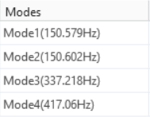
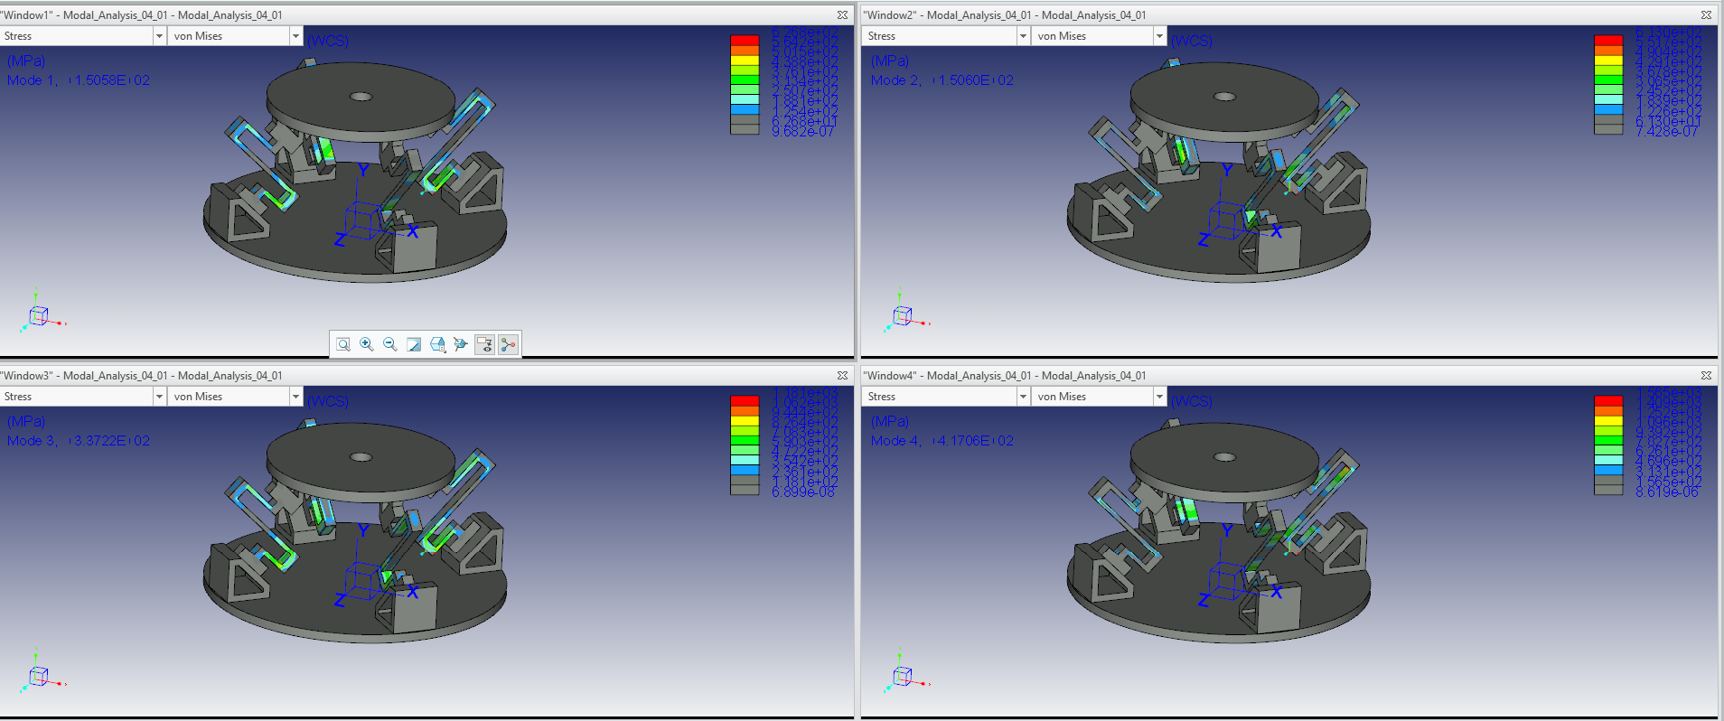
Initial Isolator Modal Analysis Results

Slide 10
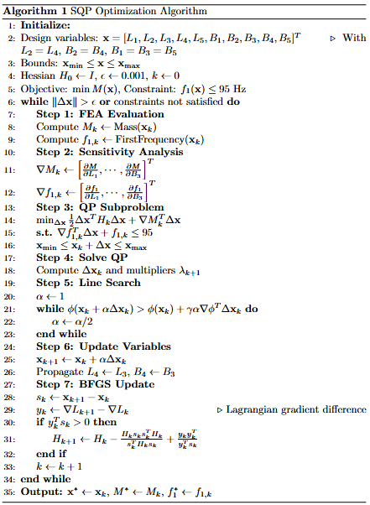
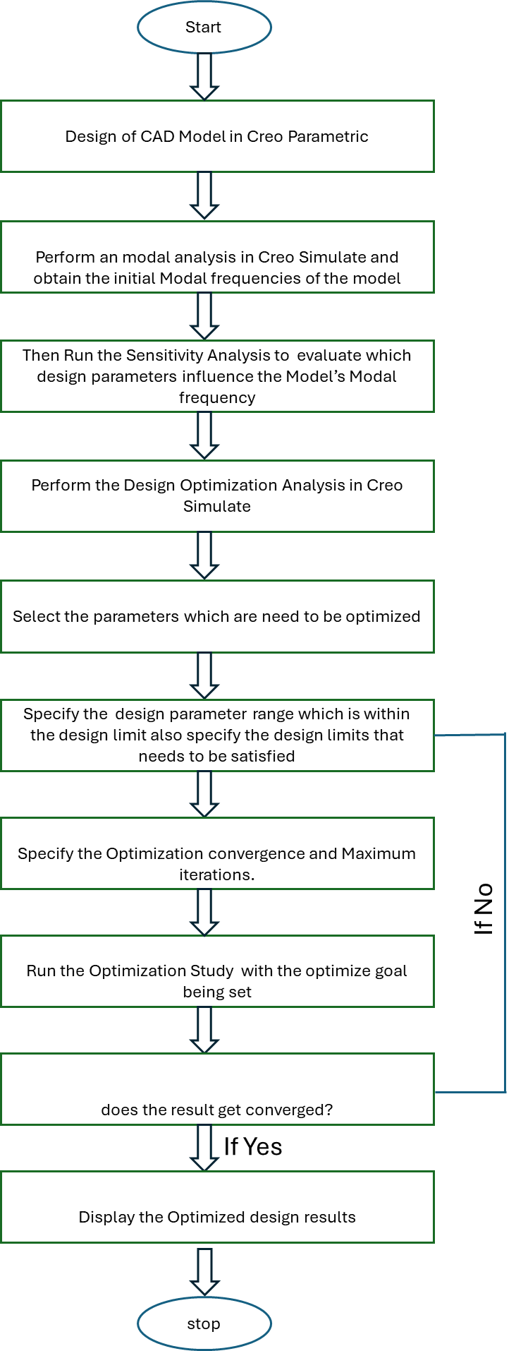


Design Optimization of the Folded beam Structure
L₄
B₄
B₅
L₅
constrained
B₃
L₃
B₁
L₁
constrained
B₂
L₂

Slide 11
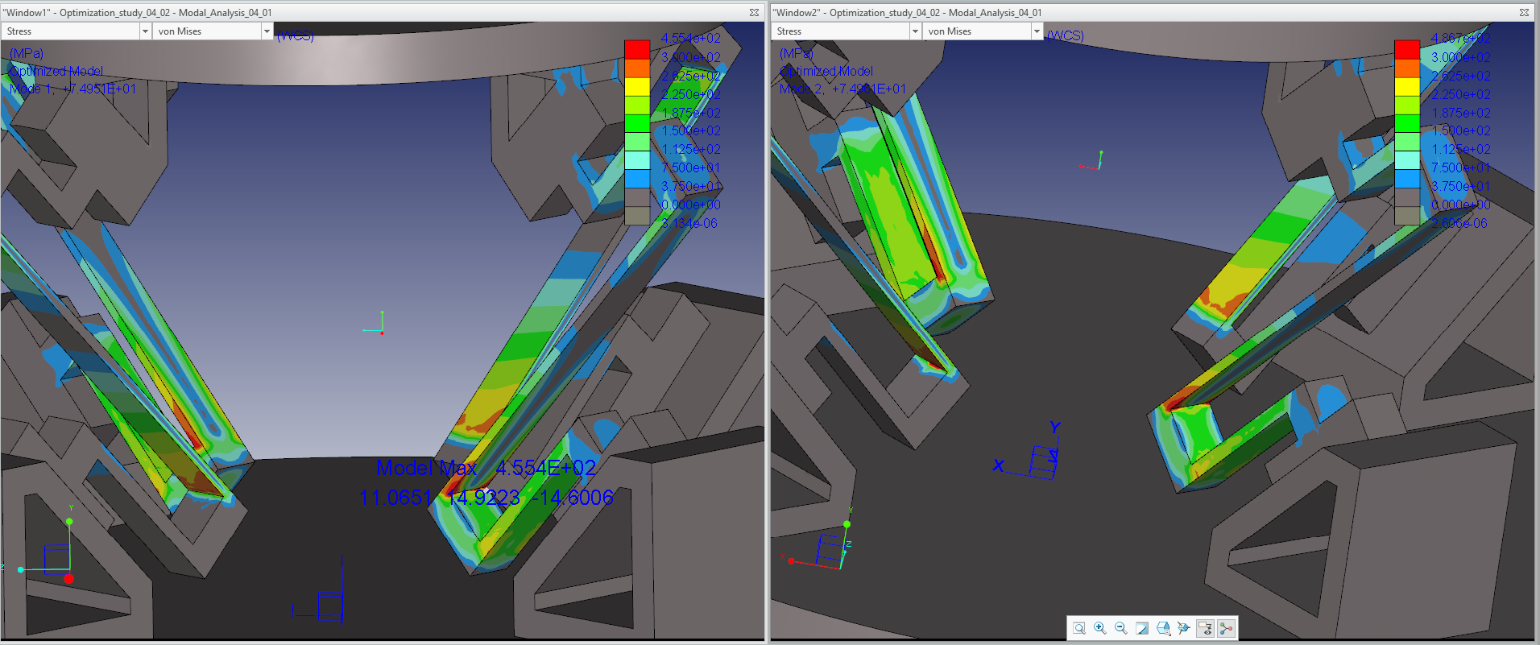
Optimized single folded structure Analysis
After Optimization
Here FOS is <1.5 ( Not suitable for Engineering Applications)

Slide 12
Optimization Design Parameters and Modifications
Design Limits : Modal frequency < 95 Hz
Variables: ( in mm)
1st Set → all the horizontal length ( 4 parameters)
10< L₁ <20
30< L₂ = L₃ < 50
15 < L₄ < 25
2nd Set → all the horizontal thickness (4 parameters)
1 < T <3
Where, T = T₁ =T₂ = T₃ =T₄
Observations:
Model frequencies are highly dependent on the horizontal beam dimensions .
2) No Variation during Vertical beam dimension changes.
3) From the prior Sensitivity Analysis we could found that the optimal width and height for the vertical beam structures those are
Overall folded beam Width : 5mm
Vertical beam Height:4 mm

Slide 13
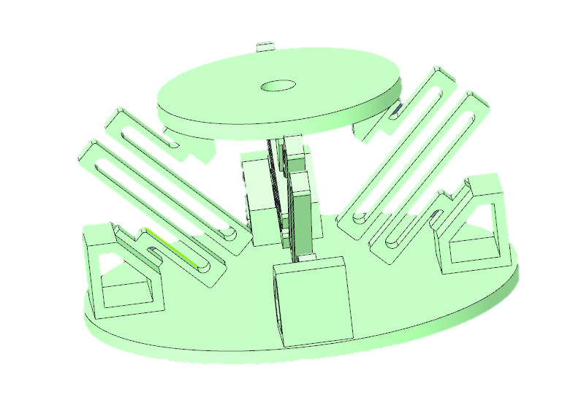
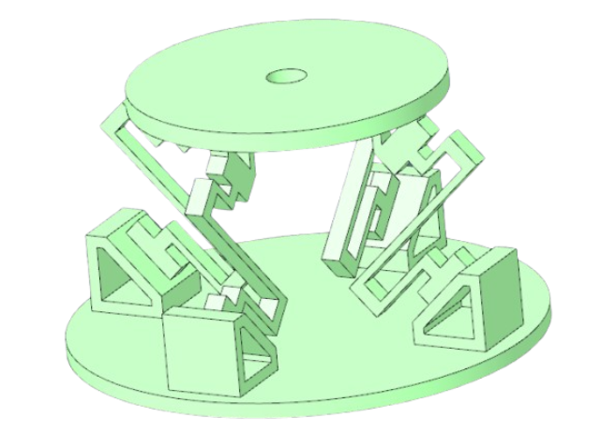
Folded Beam Design Modifications

Slide 14
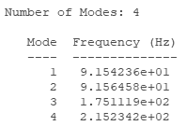
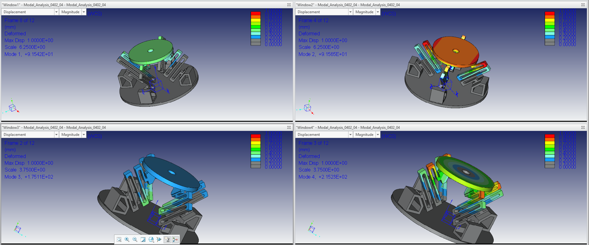
Modified Isolator Design after Optimization
After going through thee same steps of optimization procedure we could obtain the following results

Slide 15
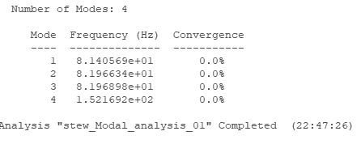
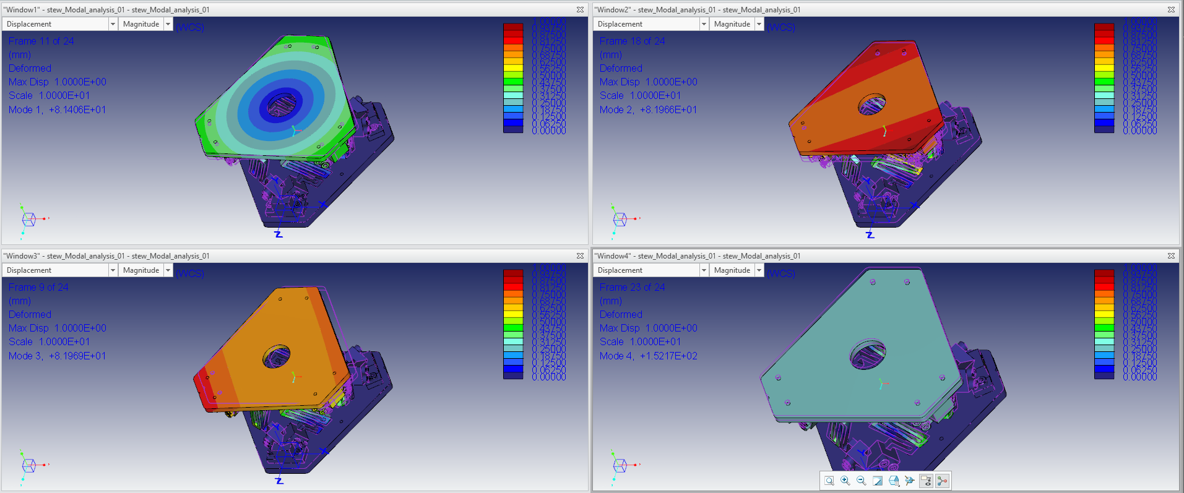
Modal Analysis for the Novel 3–3 Stewart–Gough Isolator Platform

Slide 16
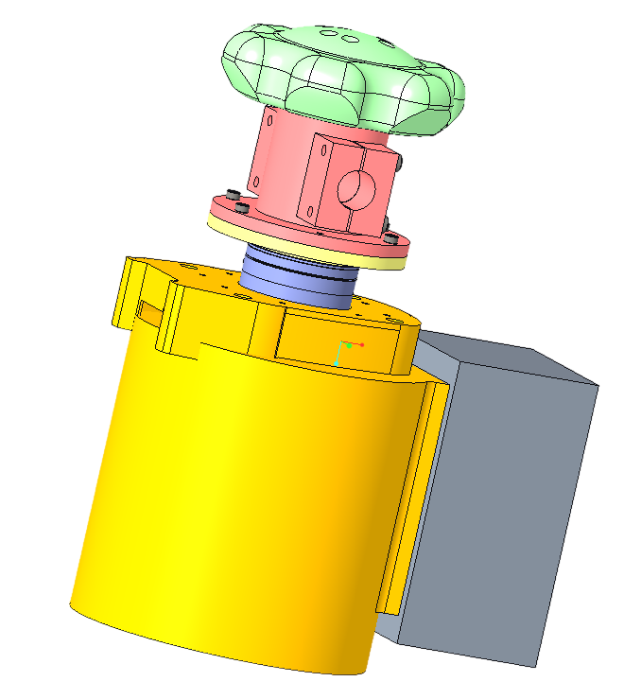
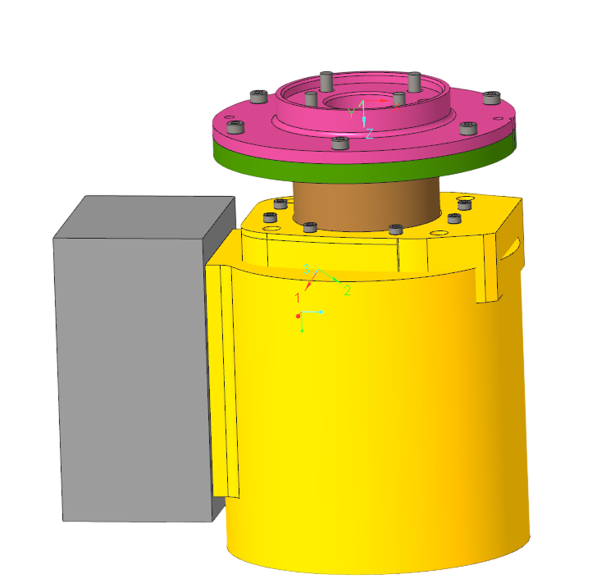
CAD Models of the Tool Mountings
Doosan Direct Tool Flange
Haptic Device Interface

Slide 17
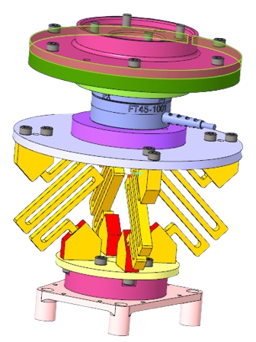
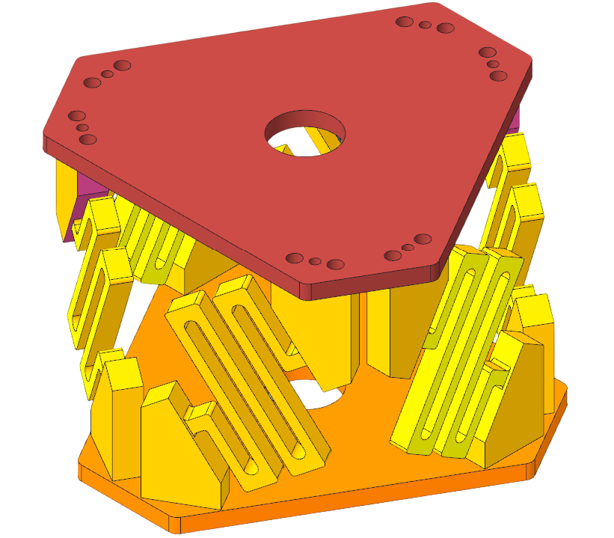
CAD Models of the Vibration Isolators
An Distributed Integrated folded beam isolator platform
A Novel MSSM (Minimal Simplified Symmetric Manipulator) architecture type of 3–3 Stewart–Gough isolator platform

Slide 18
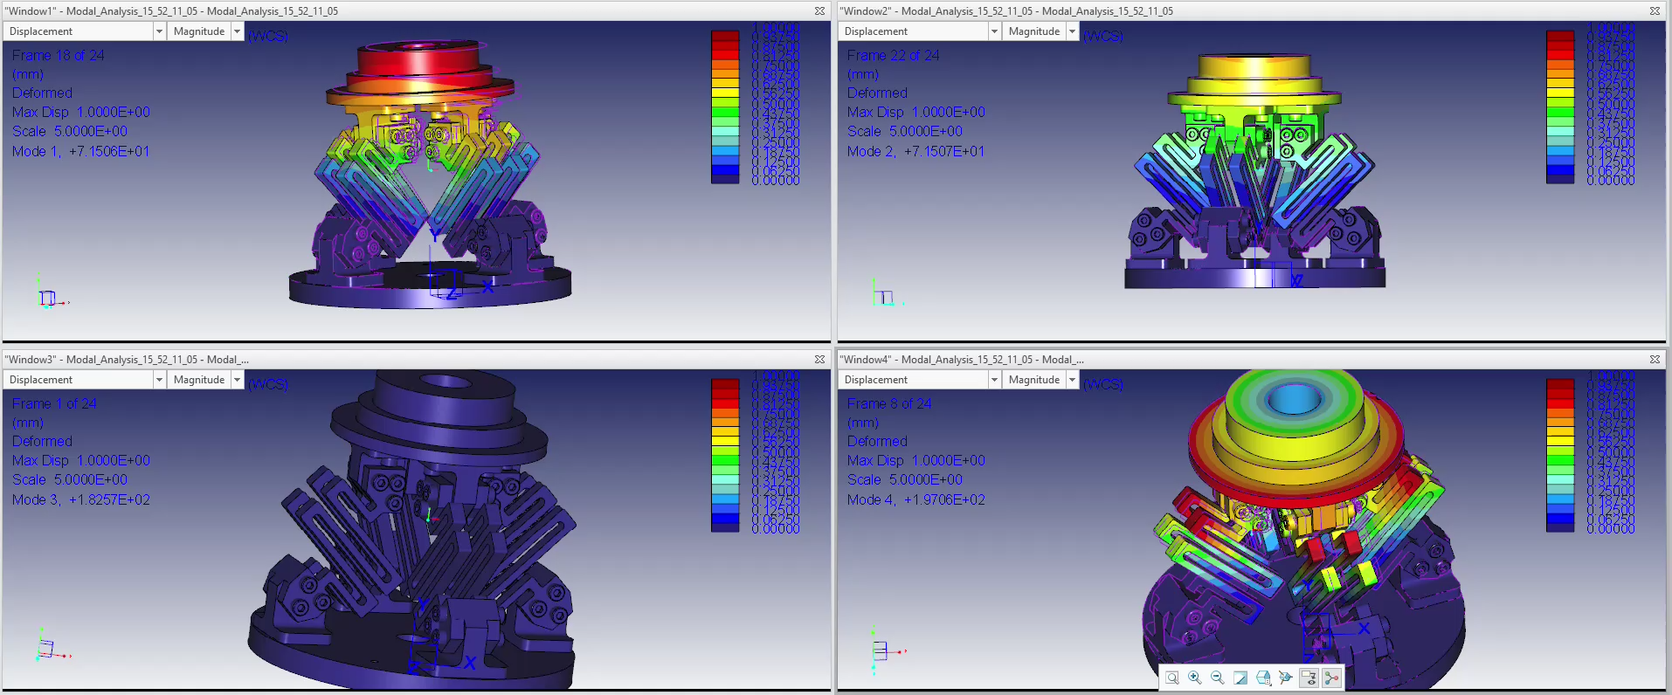
Analysis Videos

Slide 19
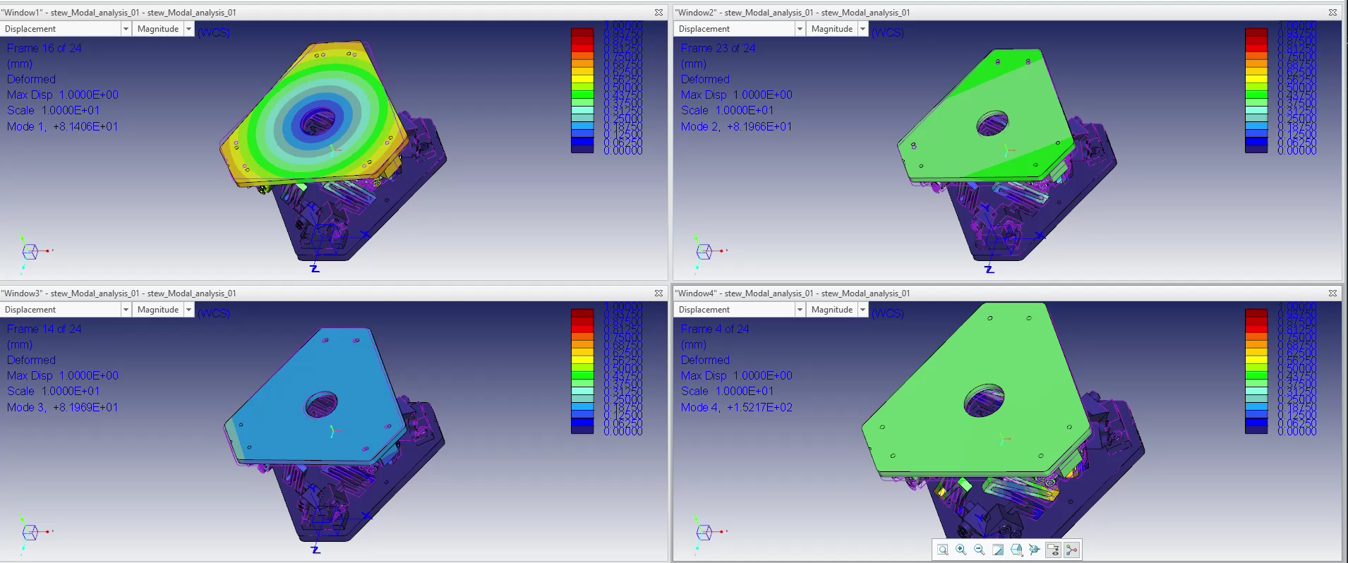
Analysis Videos

Slide 20
References
Iyer, R. B., Jatti, V. K., Yadav, Y., Verma, A., Desai, J., & Dewan, C. P. (2017). Design optimization of CAD model. Materials Today: Proceedings, 4(8), 7357-7364.
Shi, H. T., et al. "Vibration isolation methods in spacecraft: A review of current techniques." Advances in Space Research (2024).
Zou, X., Li, Z., Zhao, X., Sun, T., & Zhang, K. (2014, August). Study on the auto-leveling adjustment vibration isolation system for the ultra-precision machine tool. In 7th International Symposium on Advanced Optical Manufacturing and Testing Technologies: Advanced Optical Manufacturing Technologies (Vol. 9281, pp. 606-612). SPIE.
Modeling, design and analysis of low frequency platform for attenuating micro-vibration in spacecraft by D. Kamesh et al.,2010.
EDITION, THIRD. "Introduction to optimum design." 2012,
Toogood, Roger, and P. Eng. "Pro/MECHANICA tutorial structure." Schroff Development Corporation (2001).
Mysłek, Adam, and Henryk Sanecki. "Optimization of hydraulic crane prototype." Symulacja w Badaniach i Rozwoju 8.3-4 (2017): 105-113.
Ding, Bingxiao, Xuan Li, and Yangmin Li. "FEA-based optimization and experimental verification of a typical flexure-based constant force module." Sensors and Actuators A: Physical 332 (2021): 113083.
Merlet, Jean-Pierre. Parallel manipulators. Part I: Theory design, kinematics, dynamics and control. Diss. INRIA, 1987.
NPTEL “Vibration Control” Lectures Dr. S.P. Harsha. Indian Institute of Technology Roorkee.
Experimental research on a vibration isolation platform for momentum wheel assembly by Weiyong Zhou et al.,2013.
Performance Analysis of a Flywheel Microvibration Isolation Platform for Spacecraft by Zhanji Wei et al.,2015.
Cao, Max Yiye, Stephen Laws, and Ferdinando Rodriguez y Baena. "Six-axis force/torque sensors for robotics applications: A review." IEEE Sensors Journal 21.24 (2021): 27238-27251.
Shi, L., Sun, B. Modeling and optimization of vibration response characteristics of the orbital sander based on surrogate model. Struct Multidisc Optim 57, 2259–2271 (2018).
L. Shi and B. Sun, “Mathematical modeling and vibration simulation of an orbital sander,” Vibroengineering PROCEDIA, Vol. 22, pp. 176–181, Mar. 2019,

Slide 21

Thank you very much for your Attention

Slide 22
Work Status Update for the Project Magician
Insert the initial manual test data and also mention the optimal range of handling the tool and also mention the grid size of the sanding pad. And a short description.

